Slide 1
Heart Disease Data Analysis

Slide 2
Introduction
This presentation provides an analysis of heart disease data using Power BI. The data includes various factors such as age, gender, chest pain, blood pressure, cholesterol, maximum heart rate, and ST depression.

Slide 3
Data Overview
The dataset includes records of heart disease cases, categorized as 'Absent' or 'Present'. This analysis aims to identify patterns and insights related to heart disease occurrences.

Slide 4
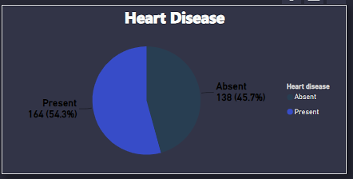
Heart Disease Analysis
54.3% of the individuals (164 people) in the dataset have heart disease.
45.7% of the individuals (138 people) do not have heart disease.
The data shows that heart disease is slightly more prevalent than its absence in the studied population.

Slide 5
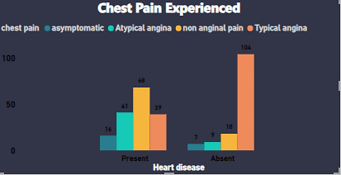
Chest Pain Analysis
Individuals with Heart Disease:
Atypical angina (68 cases) and typical angina (39 cases) are the most common types of chest pain experienced by individuals with heart disease.
Non-anginal pain (41 cases) and asymptomatic (16 cases) are less common among those with heart disease.
Individuals without Heart Disease:
Typical angina (104 cases) is the predominant type of chest pain experienced by individuals without heart disease.
Non-anginal pain (18 cases) and atypical angina (9 cases) are less common.
Very few individuals without heart disease are asymptomatic (7 cases).
Comparative Analysis:
Typical angina is more prevalent among individuals without heart disease compared to those with heart disease.
Atypical angina is more common among individuals with heart disease.
Non-anginal pain is relatively evenly distributed between the two groups.
Asymptomatic cases are slightly more common in individuals with heart disease.

Slide 6
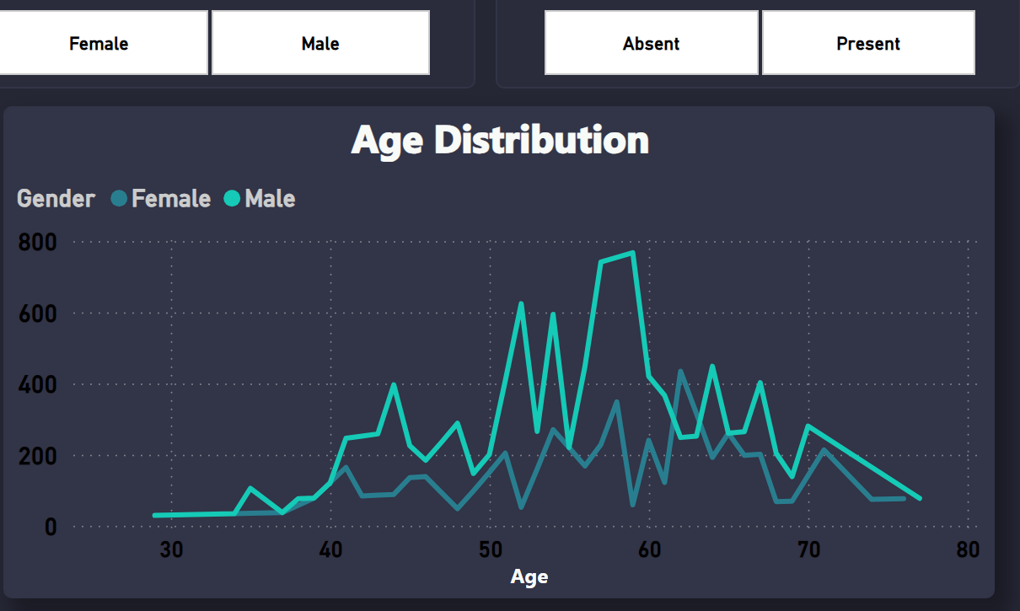
Age Distribution Analysis
The age of individuals in the dataset ranges from approximately 25 to 80 years.
There are noticeable peaks around the ages of 40 and 50, indicating higher concentrations of individuals in these age groups for both genders.
At age 37, both male and female counts are equal at 37 each.
There is a decline in the number of individuals as age increases beyond 60, with relatively fewer individuals represented in the older age brackets (above 70).
The data suggests that middle-aged individuals (40-50 years) are more prevalent in this dataset.

Slide 7

Gender Distribution Analysis
The chart indicates that the number of heart disease cases in males (206) is more than double that in females (96). This suggests that males are at a significantly higher risk of developing heart diseases compared to females.

Slide 8
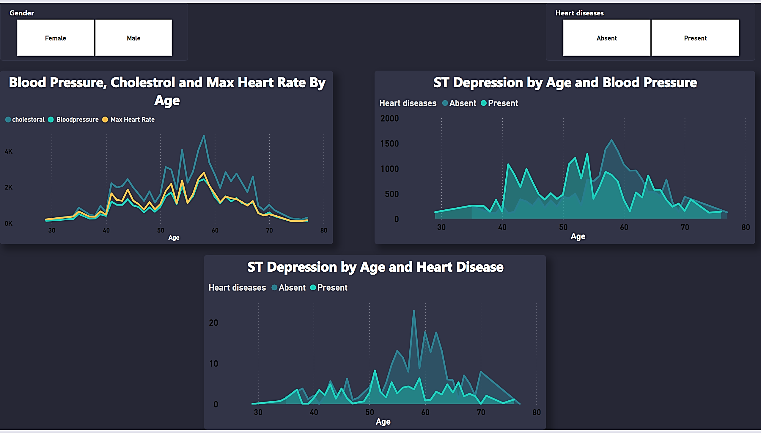
Blood Pressure, Cholesterol, and Max Heart Rate Analysis
Blood pressure, cholesterol, and max heart rate all peak around the age of 50-60.
All three health indicators show a gradual increase starting from around age 30, reaching their highest levels at 50-60.
After the age of 60, there is a noticeable decline in blood pressure, cholesterol, and max heart rate levels.

Slide 9
ST Depression By Age and Blood Pressure Analysis
ST depression peaks between ages 40 and 55 in individuals with heart disease.
Higher ST depression levels are observed in heart disease patients compared to those without heart disease.
ST depression declines after age 60 for both groups.

Slide 10
ST Depression By Age and Heart Disease Analysis
Presence of heart disease with ST depression peaks around the age group of 50-60.
Increase in ST depression with heart disease starts around age 30, peaks at 50-60, and decreases beyond 60.
Presence of ST depression with heart disease decreases after age 60, possibly due to increased mortality or better management

Slide 11
Duplicate of Page 1
Notes:
Heart Disease
No alt text provided
Age Distribution
No alt text provided
Heart diseases by Gender
No alt text provided
textbox
No alt text provided
slicer
No alt text provided
slicer
No alt text provided
Chest Pain Experienced
No alt text provided

Slide 12

Duplicate of Duplicate of Page 1
Notes:
Blood Pressure, Cholestrol and Max Heart Rate By Age
No alt text provided
ST Depression by Age and Blood Pressure
No alt text provided
ST Depression by Age and Heart Disease
No alt text provided
slicer
No alt text provided
slicer
No alt text provided

Slide 13
Conclusion
The heart disease data analysis provides valuable insights into the factors associated with heart disease occurrences. This information can be used to improve preventive measures and treatment strategies.

Slide 14
Thank You

